Slide 1

Agile Framework FDD and asd
Deepak Vishwakarma

Slide 2

Agile Framework Feature Driven Development(FDD)
Feature Driven Development (FDD) is one of the Agile Software Development Methodologies.
Came into view in last 15 years as an alternative to traditional Waterfall development.
FDD is a process that begins with high level planning to define the scope of the project which then moves into incremental delivery
Main Advantages: Easy to understand the feature-based process, Scalability
Main Disadvantages: Promotes individualism, Undefined iterations, Potential Model Centric failures

Slide 3
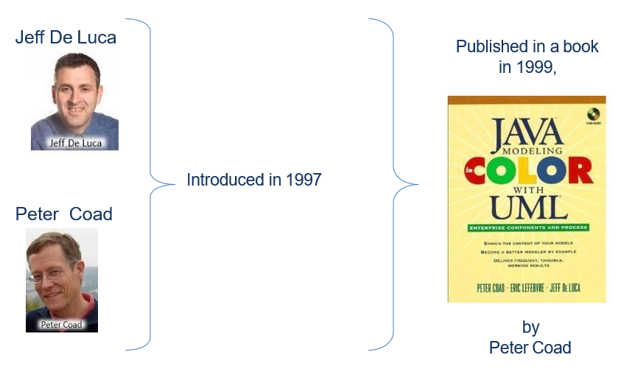
Agile Framework (FDD)

Slide 4
Agile Framework Crystal Methods
Communication
Consider developers as nodes in a communication network, all potentially linked to each other by communication channels. The number of potential communication channels increase dramatically as more number of developers are added
Complexity
FDD decomposes the entire problem domain into tiny problems, which can be solved in a small period of time, usually 2 weeks decomposed problems independent to each other reduces the need of communication.
FDD splits the project into iterations so that the distance in time between analysis and test is reduced early discovery of errors reduces the cost of fixing the errors.
Quality
Different persons have different perception of software quality
This makes necessary to view quality as a spectrum, with internal quality at one end and external quality at other end.

Slide 5
Agile Framework FDD Roles
Key Roles
Project Manager (PM)
Chief Architect (CA)
Development Manager (DM)
Chief Programmers
Class Owners
Domain Experts
Supporting Roles
Release Manager
Language Guru
Build Engineer
Toolsmith
System Administrator
Additional Roles
Testers
Deployers
Technical Writer

Slide 6
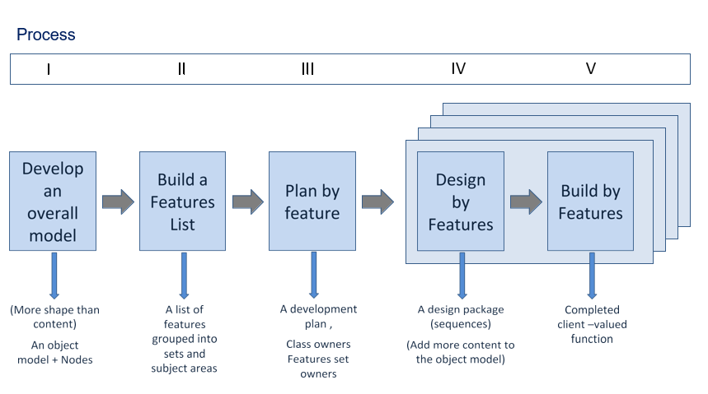
Agile FDD Process

Slide 7
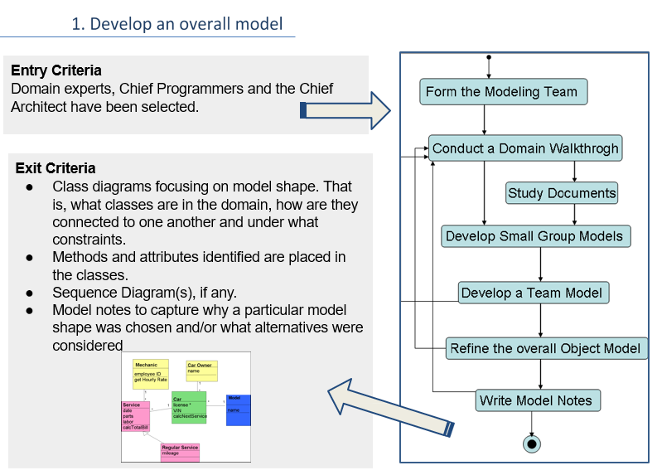
Agile FDD Process – Develop Overall Model

Slide 8
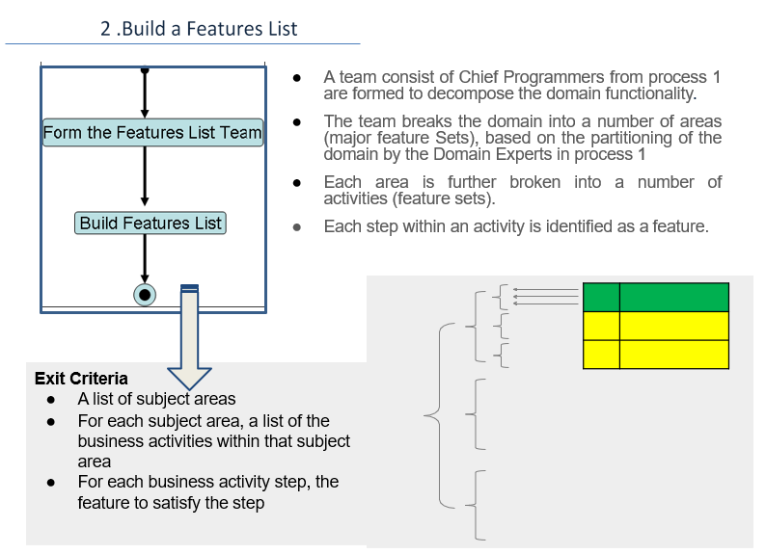
Agile FDD Process – Build Feature List

Slide 9
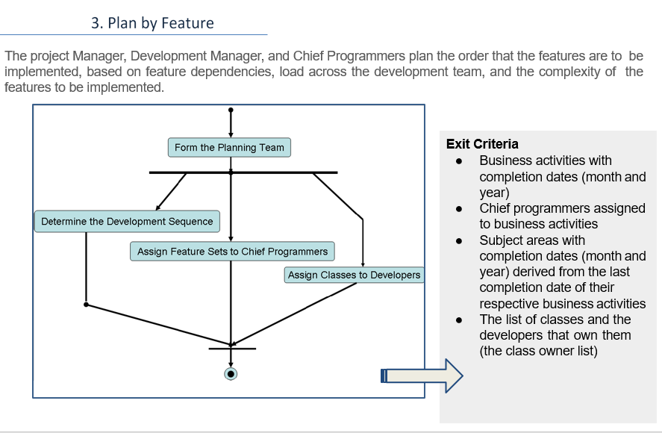
Agile FDD Process – Plan by Feature List

Slide 10
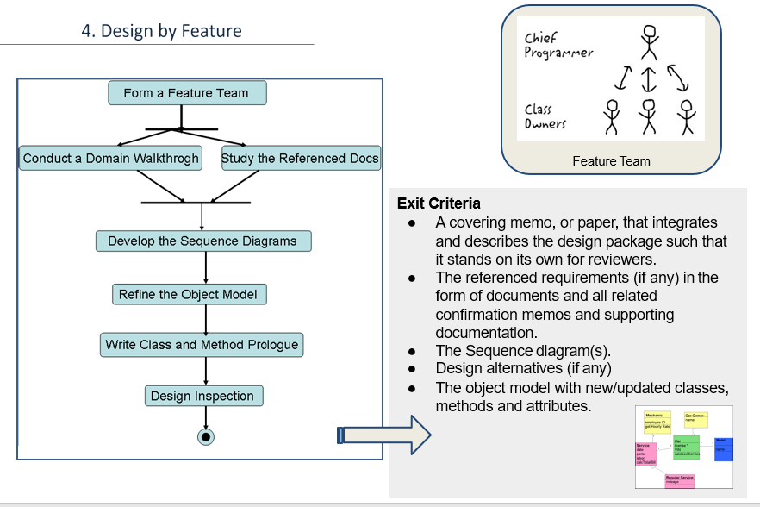
Agile FDD Process – Design by Feature List

Slide 11
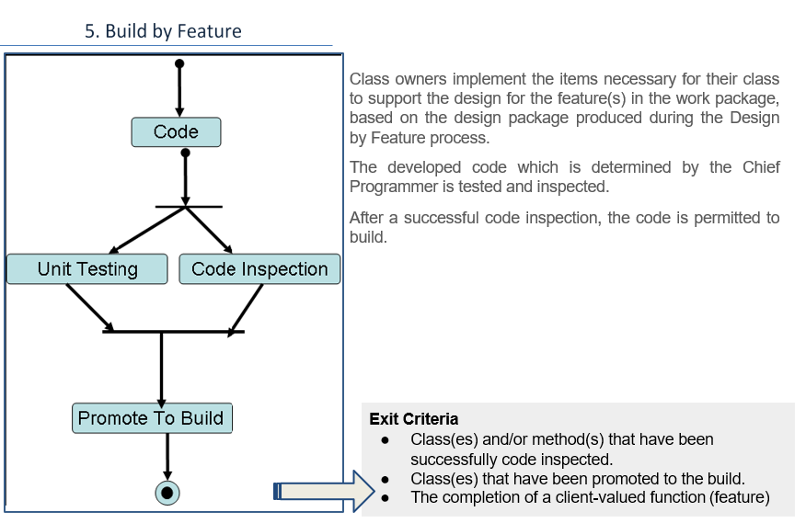
Agile FDD Process – Build by Feature List

Slide 12
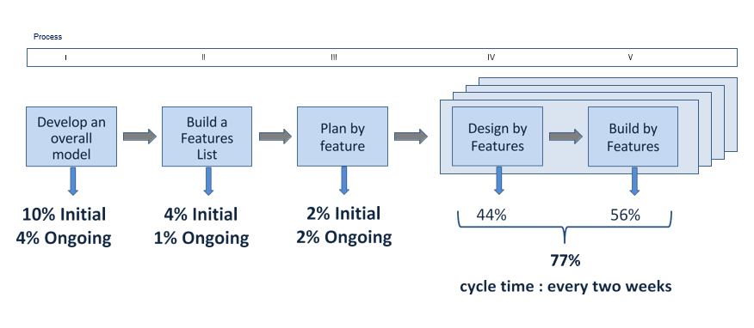
Agile FDD Guidelines for time spent in each process

Slide 13
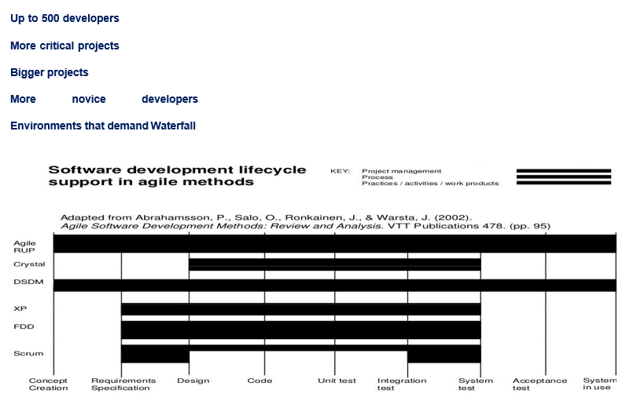
Agile FDD Can be implemented with

Slide 14
Agile Adaptive Software Development(ASD)
The Adaptive model is built from a different point of view. Though cyclical like the Evolutionary model, the names of the phase reflect the unpredictable nature of increasingly complex systems.
Adaptive Development goes further than its evolutionary heritage in two key ways-
It explicitly replaces Determinism with Emergence.
It goes beyond a change in life cycle to a deeper change in management style.

Slide 15
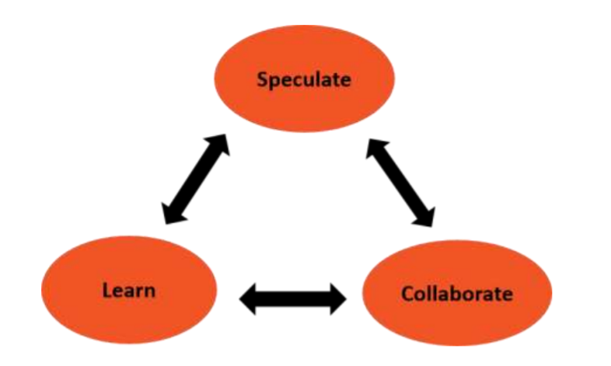
Agile Adaptive Software Development(ASD)

Slide 16
Agile Adaptive Software Development(ASD)
The three phases in Adaptive Software Development Lifecycle:
Speculate: Speculate replaces the deterministic word planning, planning of product specifications or planning of project management tasks.
Collaborate: Collaborate represents drawing a balance between o Managing in the traditional project management sense, and o Creating and maintaining the collaborative environment needed for emergence. Collaborative Activities build products, keeping up the pace of changes in the environment.
Learn: Learn aims both, the developers and the customers, to use the results of each development cycle to learn the direction of the next.

Slide 17
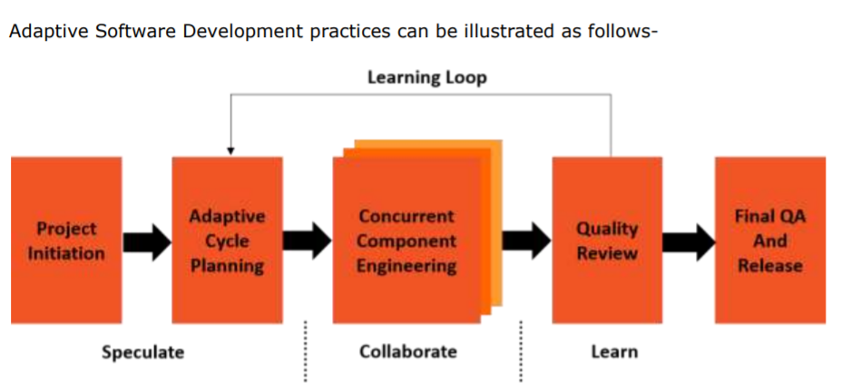
Agile Adaptive Software Development(ASD)

Slide 18
Reference and bibliography
Coad, Peter, et al. Java modeling in Color with UML.Upper Saddle River, NJ Prentice Hall PTR, 1999. Stephen R. Palmer, 2002. A Practical Guide to Feature-Driven Development. 1 Edition. Prentice Hall.
Sadhna Goyal. “Agile Techniques for Project Management and Software Engineering”, Major Seminar on Feature Driven Development, Technical University-Munich, 2007-2008.
http://www.featuredrivendevelopment.com
http://en.wikipedia.org/wiki/Feature_Driven_Development
Adaptive Software Development: A Collaborative Approach to Managing Complex Systems, Highsmith, J.A., 2000 New York: Dorset House, 392pp, ISBN 0-932633-40-4

